Slide 1
Building Your Personal Portfolio
Steven Mortimer | March 1, 2018

Slide 2
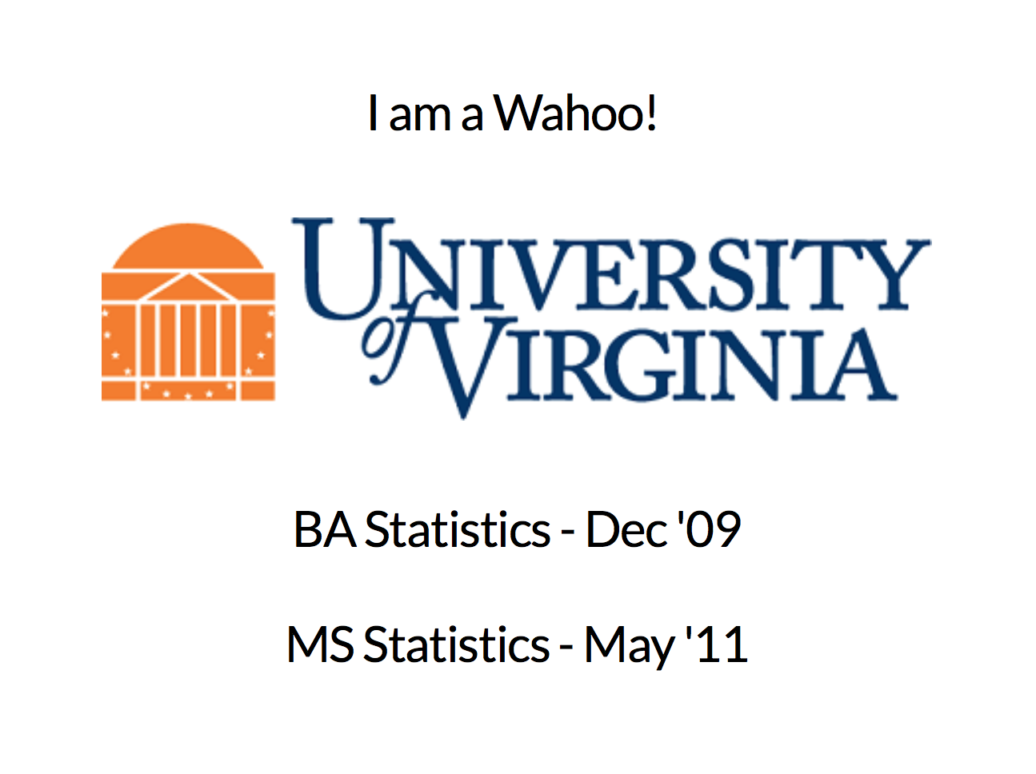
About Me

Slide 3
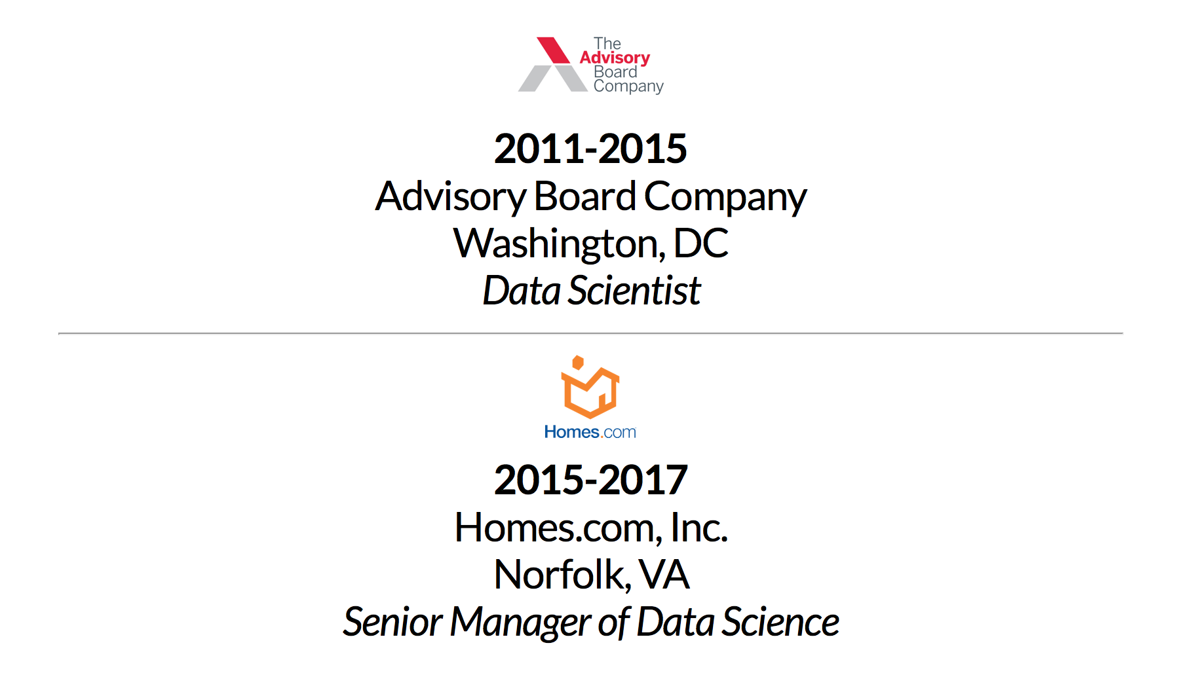
About Me

Slide 4
Getting back to building portfolios…

Slide 5

Why Building a Digital Profile is Good
Practice coding skills
Practice communication skills
Practice collaboration skills
Practice!

Slide 6

Other Reasons to Build a Digital Profile
To prove you are a skilled job candidate.
You like it.
You use it to bookmark learnings.

Slide 7


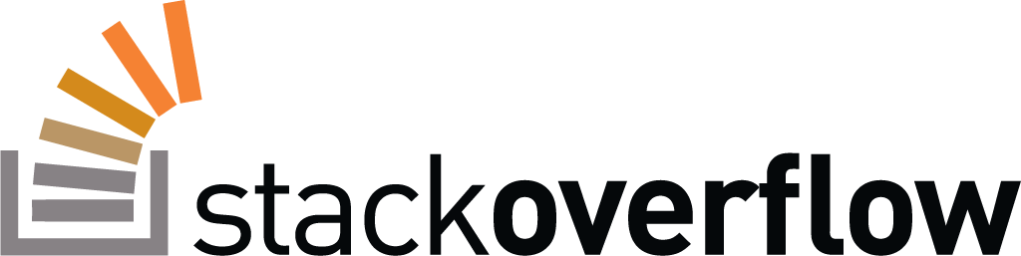

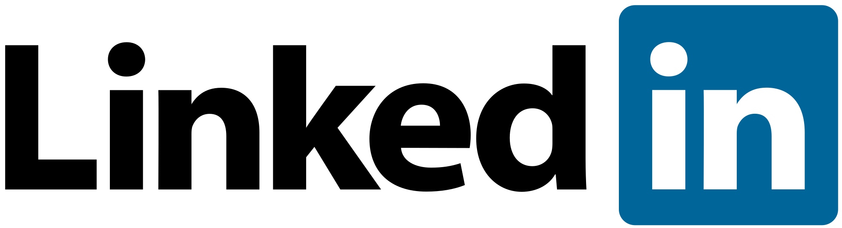
Modes – GitHub & Everything Else

Slide 8
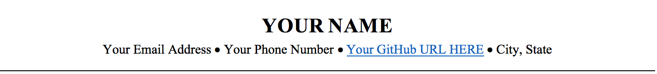
Put Your GitHub URL on Your Resume
A resume with a strong GitHub profile will open more doors than anything else.

Slide 9

Repositories – Quality over Quantity
Hiring managers and future teammates are looking for:
Folder Structure
Code Structure
Functions?
Comments?
Readable?
Aesthetics
User in mind (collaboration)?
Notes:
2 really good repositories better than 5.

Slide 10
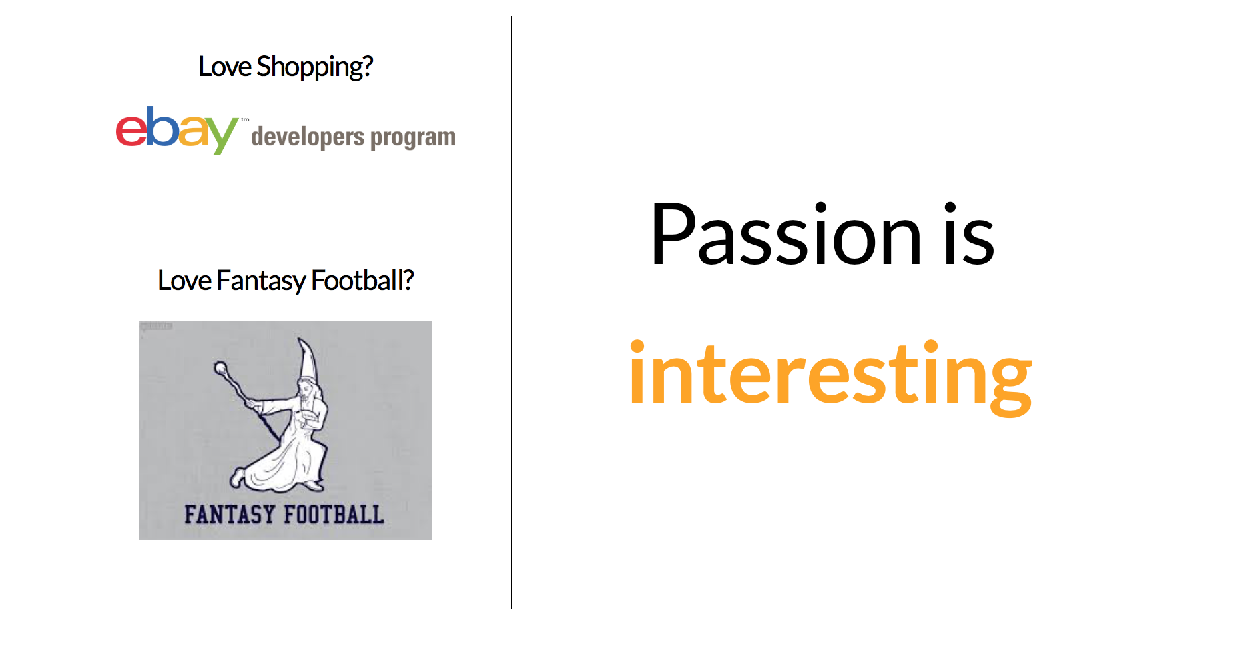
Upload Projects that Interest You

Slide 11
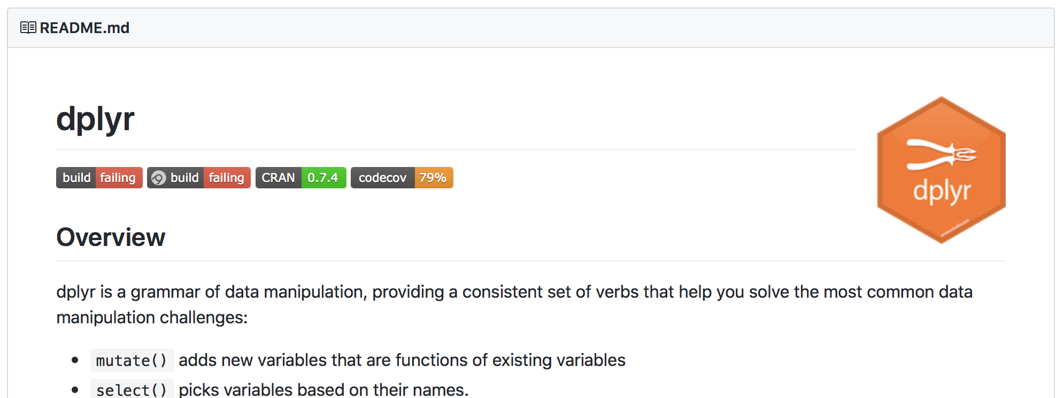
Make a Good README
Badges
Code Examples
Images
Source: https://github.com/tidyverse/dplyr

Slide 12
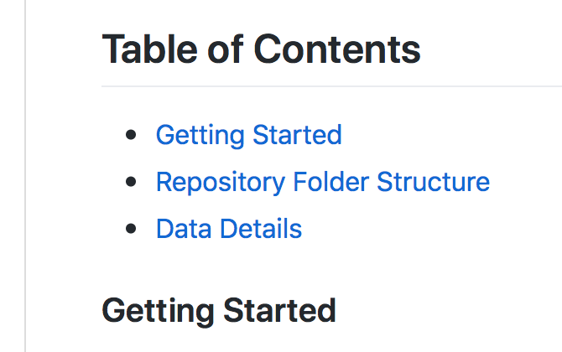
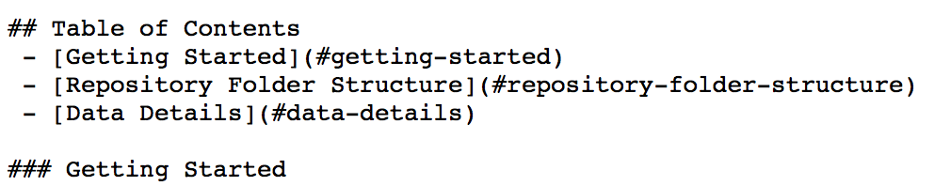
Add README Table of Contents
Note: Adding a “Quick Start/Getting Started” section shows you’re proactive about collaborating with others and getting people up and running.

Slide 13
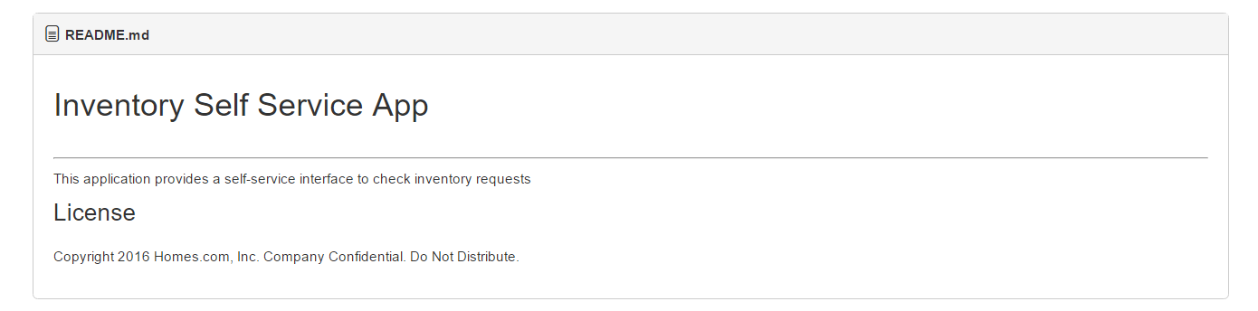
Avoid the “Bare Bones” README

Slide 14
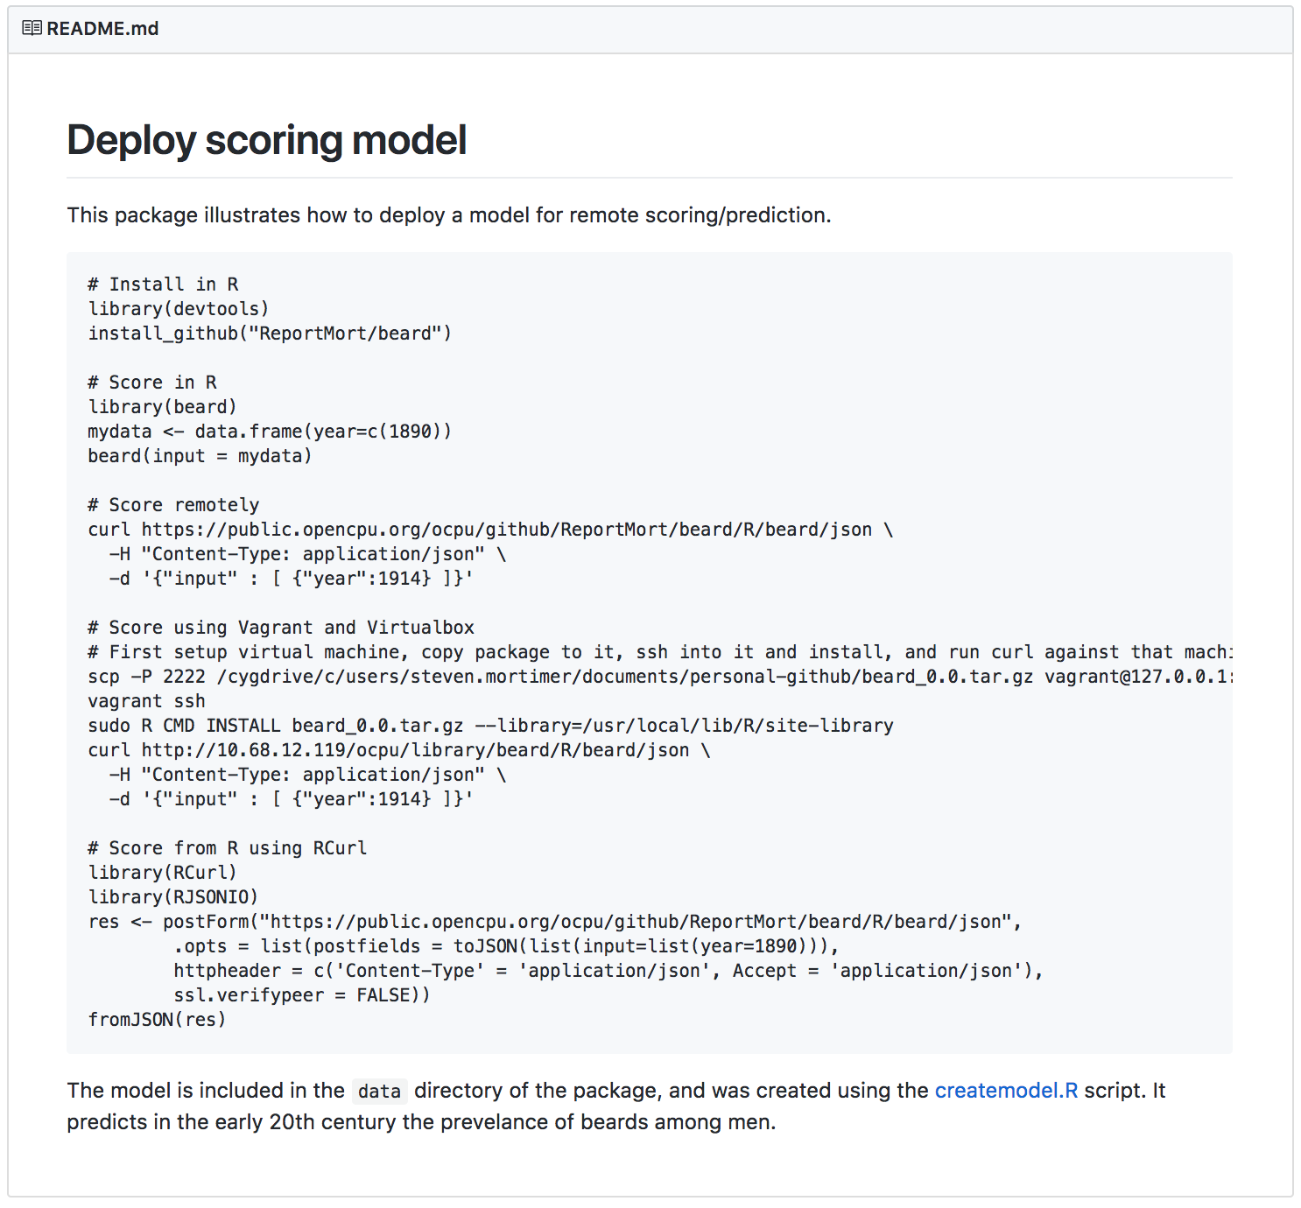
Avoid the “Wall of Text” README

Slide 15
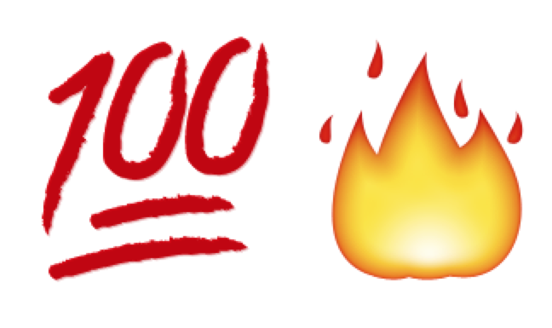
Summary of GitHub Recommendations
Resume + GitHub Link =
Assume your future employer is reading your code
Upload things you can speak passionately about
Make a great README

Slide 16
One More Thing Concerning GitHub…
Think of an open source project you use.
Could the documentation be better?
Commit to it!
Add to your resume

Slide 17
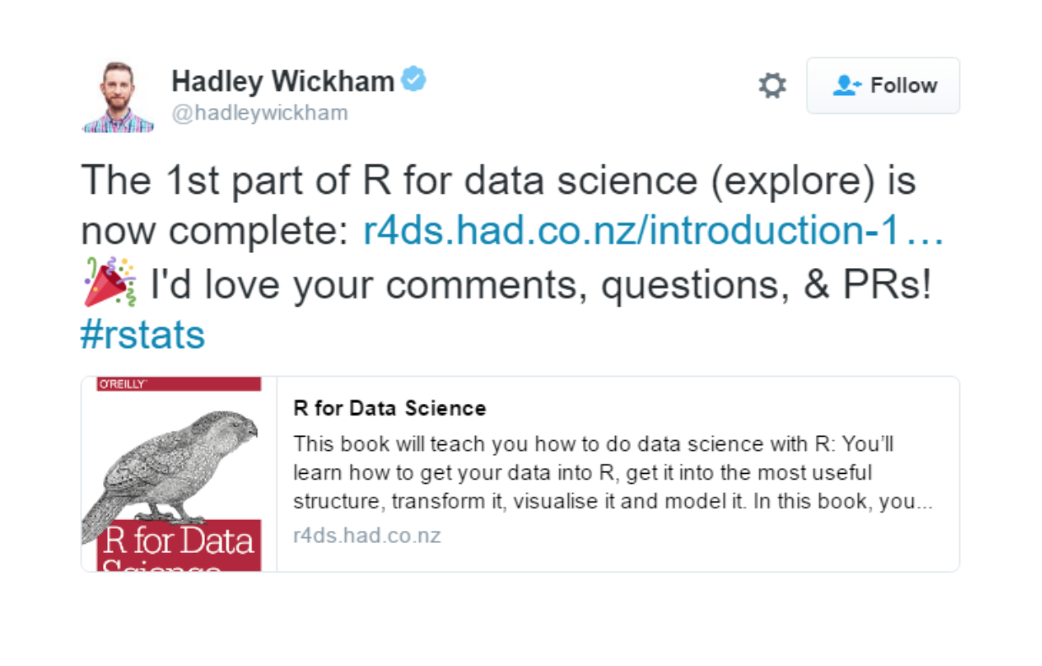
Taking the Open Source Invitation

Slide 18
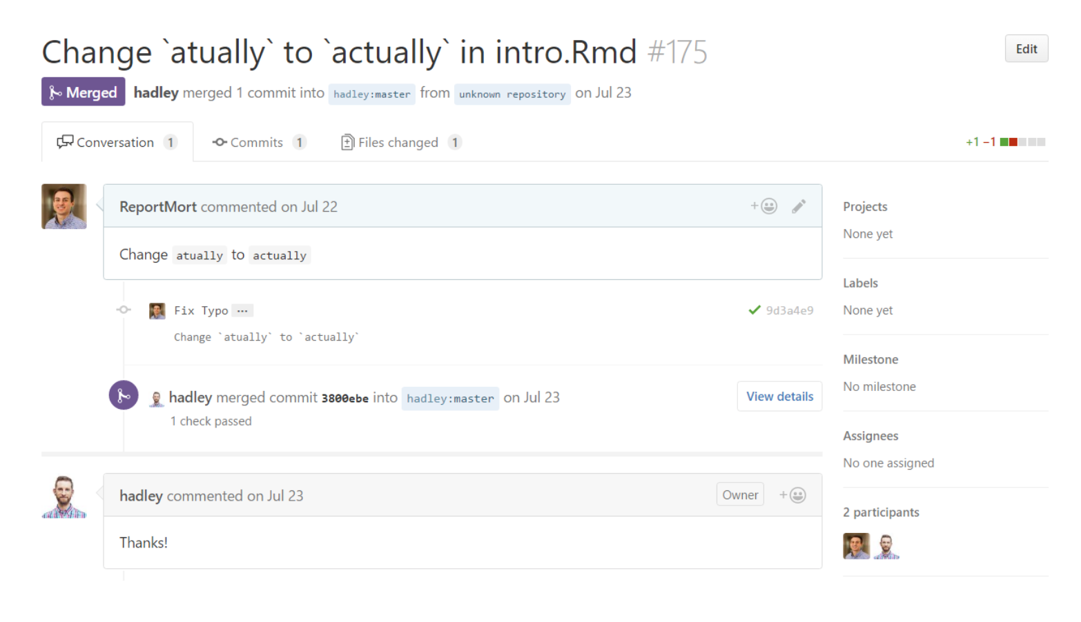
Even Tiny Contributions are Valid!

Slide 19
Personal Website/Blog
No website is better than a bad website. Hiring managers would rather look at your GitHub.
Data Scientist != Web Developer
It’s hard to keep up! Serious time investment.
What is your vision and purpose?

Slide 20
The Social Sites

Slide 21
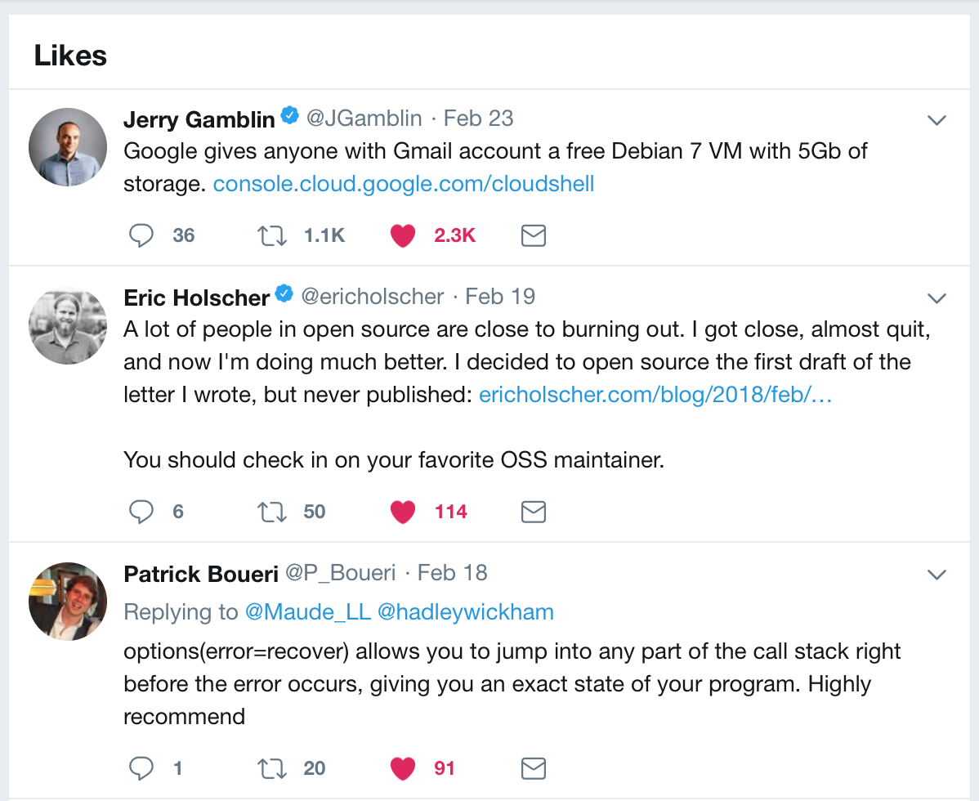
Uses for Twitter
Promote your own blog posts
Bookmark links or articles with “like”/”heart”
Track influencers to stay current/knowledgeable

Slide 22
Leveraging Twitter for Job Interviews
Interview Tip #1:
Bond over recent community news.
“The Anaconda Distribution 5.0 came out and introduced JupyterLab, the next-gen version of Jupyter Notebooks. What do you think?!”
“PyCon 2018 is coming up in May, is anyone from the office going?”
Interview Tip #2:
Have a preference on common tools.
”I like using PyCharm over Jupyter notebooks because of the better git functionality”
“I like using Seaborn over Bokeh for plotting because it’s visually cleaner to my eye”

Slide 23


Stack Overflow
A code kata is an exercise in programming which helps programmers hone their skills through practice and repetition.*
Helping others = expanding network
*Source: Wikipedia

Slide 24

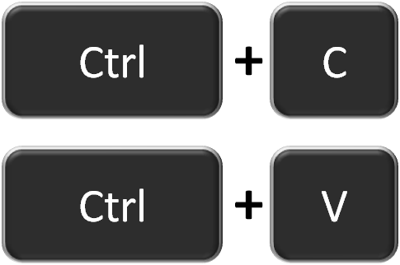
LinkedIn
Don’t neglect. Any non-tech folks will be looking here for your information (Recruiters, Managers, etc.)
It doesn’t have to be hard, just copy/paste from resume

Slide 25
Final Thoughts
Building a profile builds skills and others’ awareness of your skills.
If you could devote time to anything, go for GitHub.
Don’t be scared to contribute to open source. It’s not just for “experts”.
Other mediums for promoting your “brand” and profile are good.
Personal Website: Strike balance that works for you
Twitter: Use it to stay current and promote yourself
Stack Overflow: Code Kata + Showing off skills to others with questions
LinkedIn: Staying in front of your less technical audiences

